Slide 1

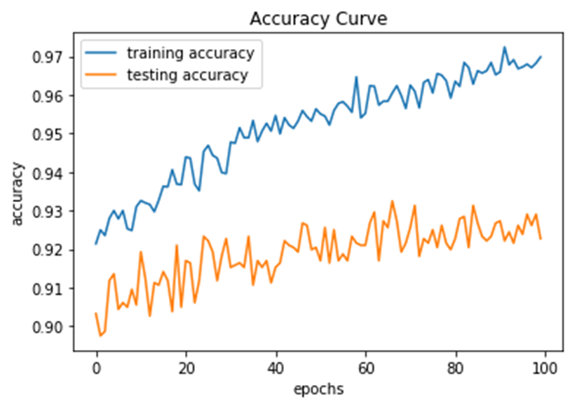
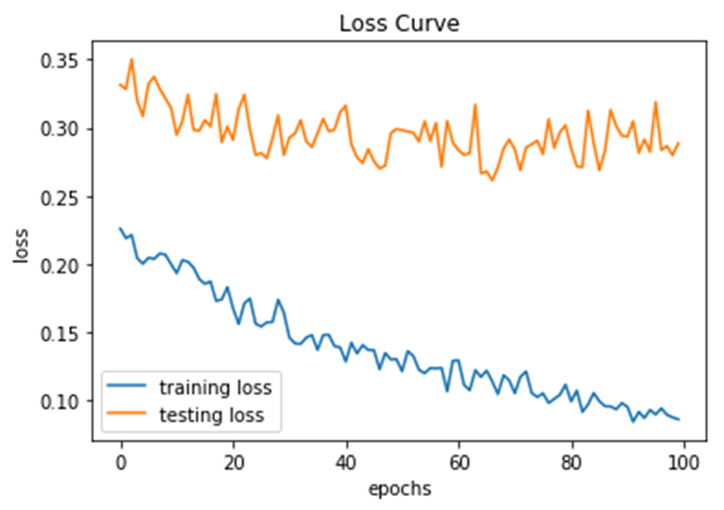
URBAN-SOUND CLASSIFICATION
Kunku Sai Krishna Mentors: Ali Motamedi Pace University, Seidenberg School of CSIS
Abstract
The UrbanSound8K dataset serves as a cornerstone in the field of urban sound classification, providing researchers with a comprehensive benchmark dataset for evaluating classification algorithms. Developed by the research community, this dataset encompasses a diverse array of urban soundscapes captured from various environments, including urban streets, parks, transportation hubs, and residential areas.
Research Question
What are the impediments identified in student’s Scrum meeting content in a mobile development class project?
Related Work
urban sound classification, research has evolved from using basic techniques like Mel-frequency cepstral coefficients (MFCCs) and simple classifiers such as SVMs to more advanced deep learning methods. Recent trends focus on deep learning, particularly Convolutional Neural Networks (CNNs) and Recurrent Neural Networks (RNNs), which better capture complex sound patterns. Data augmentation techniques like time stretching and pitch shifting are increasingly used to enhance training datasets and model robustness. Additionally, hybrid approaches that combine CNNs with RNNs or LSTMs are gaining popularity for their ability to effectively process both the spatial and temporal aspects of sound data, promising improved accuracy and efficiency in classifying diverse urban sounds.
Dataset
The UrbanSound8K dataset is a collection of 8,732 sound clips under 4 seconds each, taken from urban environments and classified into 10 categories such as car horns, children playing, and street music. The dataset is divided into 10 folds to facilitate cross-validation in machine learning tasks aimed at urban sound classification. It's commonly used to train algorithms that automatically classify different urban sounds for applications in acoustic scene analysis, audio surveillance, and environmental noise monitoring. The presence of background noise and class imbalance are significant challenges when working with this dataset.
Methodology
The methodology for urban sound classification involves preprocessing audio data by extracting features like MFCC and normalizing them. A Convolutional Neural Network (CNN) is used due to its effectiveness in processing audio data, with hyperparameters fine-tuned for optimal performance. The data is split into training, validation, and test sets to train the model and apply regularization techniques to prevent overfitting. Model performance is evaluated using accuracy, precision, recall, and F1 score, alongside confusion matrices and ROC curves. Results are analyzed to understand the model's effectiveness across different sound categories, leading to iterative model improvements based on the insights gained. This streamlined approach ensures the development of a robust model for accurately classifying urban sounds.
Results
The urban sound classification model demonstrated strong performance across various categories, as evidenced by the precision, recall, and f1-score metrics. Notable results include high precision and recall for 'Car Horn' at 0.98 and 0.97 respectively, with an f1-score of 0.97. 'Engine Idling' also performed well with a precision of 0.92 and a notable recall of 0.98, yielding an f1-score of 0.95. Meanwhile, 'Street Music' showed room for improvement with a lower recall of 0.81, though it maintained a decent precision of 0.94, resulting in an f1-score of 0.87. Other categories like 'Air Conditioner', 'Dog Bark', and 'Drilling' showcased strong and consistent metrics, contributing to an overall average precision, recall, and f1-score of 0.92 across the dataset of 1747 samples. This illustrates the model's efficacy in accurately identifying and classifying a diverse array of urban sounds.
Conclusion & Future Work
The urban sound classification model has demonstrated robust performance with an average precision, recall, and f1-score of 0.92 across various sound categories. The high scores in categories such as 'Car Horn', 'Engine Idling', and 'Gun Shot' indicate the model's strong ability to distinguish specific urban sounds with high accuracy. However, some categories like 'Street Music' displayed relatively lower recall, suggesting occasional challenges in classifying sounds with more variable characteristics.
To enhance our urban sound classification model, we can explore advanced data augmentation, delve into more complex feature engineering, and test new neural network architectures. Systematic hyperparameter optimization and real-world testing are also crucial. These improvements aim to boost the model's accuracy and prepare it for practical applications in diverse urban environments.
References
Salamon, J., & Bello, J. P. (2017). Deep convolutional neural networks and data augmentation for environmental sound classification. IEEE Signal Processing Letters, 24(3), 279-283.
Piczak, K. J. (2015). Environmental sound classification with convolutional neural networks. In Proceedings of the IEEE 25th International Workshop on Machine Learning for Signal Processing (MLSP) (pp. 1-6).
Salamon, J., Jacoby, C., & Bello, J. P. (2014). A dataset and taxonomy for urban sound research. In Proceedings of the 22nd ACM international conference on Multimedia (pp. 1041-1044).
Choi, K., Fazekas, G., Sandler, M., & Cho, K. (2017). Transfer learning for music classification and regression tasks. In Proceedings of the 18th International Society for Music Information Retrieval Conference (ISMIR) (pp. 323-330).
Dataset
EDA
Model Training ML Classification
Model Evaluations

